Slide 1




Computer Networks
OSI Network Layer
Lecturer: Sura F. Ismail
Lecture Seven
Second Class.
Time: 9: 30- 11:30
Department: Informatics Systems Management (ISM)

Slide 2
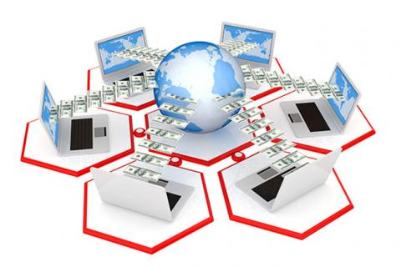
Outline
Outline
Overview
IPV4
Network Layer: Communication from Host to Host
Network Layer Protocols
IPv4: Example Network Layer Protocol
Networks: Dividing Hosts into Groups

Slide 3
1. Overview
Outline
Previous lectures explained how application data from an end device traveling to another network is first encapsulated in added bits that indicate presentation, session, and transport layer information and instructions. When the transport layer sends the protocol data unit (PDU) down to the network layer, the PDU needs the essentials of any successful journey: a destination address and directions on how to arrive efficiently and safely.
This lecture describes the process the network layer uses to convert transport layer segments into packets and get them started on their journey down the right path across different networks to the destination network. You learn how the network layer divides networks into groups of hosts to manage the flow of data packets.

Slide 4
2. IPv4
Outline
The network layer, or Open Systems Interconnection (OSI) Layer 3, provides services to exchange the individual pieces of data over the network between identified end devices. To accomplish this end-to-end transport, Layer 3 uses the processes outlined in the following sections to address the packet to the proper destination, encapsulate the packet with necessary data for delivery, route the packet through the web of connected networks that will deliver the packet to the destination network for delivery, and finally, have the destination host decapsulate the data for processing. The details of these processes are explored further in the next sections.

Slide 5
3. Network Layer: Communication from Host to Host
Outline
The network layer, or OSI Layer 3, receives segments of data, or PDUs, from the transport layer. These bits of data have been processed into a transportable size and numbered for reliability. It is now up to the network layer to use protocols to add addressing and other information to the PDU and send it to the next router along the best path, or route, to the destination network.
Network layer protocols, such as the widely used IP, are rules and instructions that devices use to enable sharing of upper-layer information between hosts. When the hosts are in different networks, additional routing protocols are used to choose routes between networks. Network layer protocols specify the addressing and packaging of a transport layer PDU and describe how the PDU is to be carried with minimum overhead.

Slide 6
3. Network Layer: Communication from Host to Host
Outline
The network layer describes four tasks to be performed:
1. Addressing
IP requires each sending and receiving device to have a unique IP address. Devices in IP networks that have IP addresses are called hosts. The IP address of the sending host is known as the source IP address, and the IP address of the receiving host is referred to as the destination IP address.
2. Encapsulation
Each PDU sent between networks needs to be identified with source and destination IP addresses in an IP header. The IP header contains the address information and some other bits that identify the PDU as a network layer PDU. This process of adding information is called encapsulation. When an OSI Layer 4 PDU has been encapsulated at the network layer, it is referred to as a packet.

Slide 7
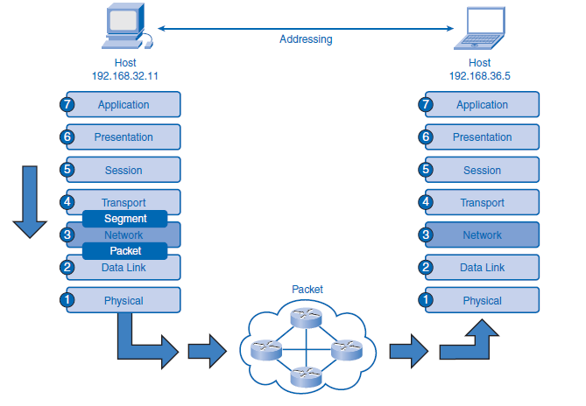
3. Network Layer: Communication from Host to Host
Outline

Slide 8
3. Network Layer: Communication from Host to Host
Outline
3. Routing
When a packet is encapsulated at the network layer, it contains all the information necessary to travel to networks near and far. The journey between networks can be very short and relatively simple, or it can be complex and involve many steps between routers connected to different networks. Routers are devices that connect networks. They specialize in understanding OSI Layer 3 packets and protocols as well as calculating the best path for the packets. Routing is the process routers perform when receiving packets, analyzing the destination address information, using the address information to select a path for the packet, and then forwarding the packet on to the next router on the selected network. Each route that a packet takes to reach the next device is called a hop. A packet can hop between several different routers en route to the destination. Each router examines the address information in the packet, but neither the IP address information nor the encapsulated transport layer data in the packet is changed or removed until the packet reaches the destination network.

Slide 9
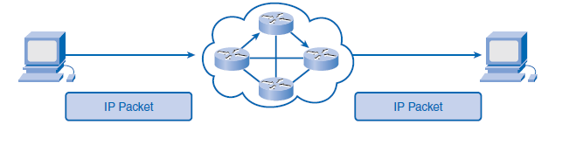
3. Network Layer: Communication from Host to Host
Outline
4. Decapsulation
An IP packet arrives at a router’s network interface encapsulated in a Layer 2 frame on the physical OSI layer. The router’s network interface card (NIC) accepts the packet, removes the Layer 2 encapsulation data, and sends the packet up to the network layer. The process of removing encapsulation data at different layers is referred to as decapsulation. Encapsulation and decapsulation occur at all layers of the OSI model. As a packet travels from network to network to its destination, there can be several instances in which Layers 1 and 2 are encapsulated and decapsulated by routers. The network layer only decapsulates the IP packet at the final destination after examining the destination addresses and determining that the journey is over. The IP packet is no longer useful, so it is discarded by the destination host. When the IP packet is decapsulated, the information in the packet is handed up to the upper layers for delivery and processing.

Slide 10
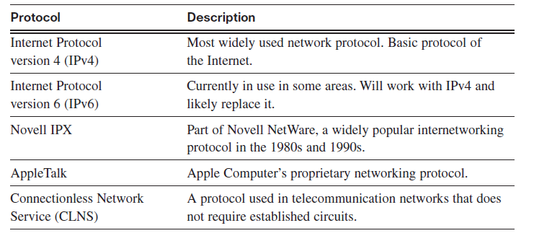
4. Network Layer Protocols
Outline
IP is the most common network layer protocol, but it is important to understand that other protocols are available that offer different features than IP.

Slide 11
5. IPv4: Example Network Layer Protocol
Outline
IPv4: Example Network Layer Protocol
Version 4 of IP (IPv4) is currently the most widely used version of IP.
IP version 6 (IPv6) is developed and being implemented in some areas. IPv6 will operate alongside IPv4 and might replace it in the future.
IP was designed as a protocol with low overhead. It provides only the functions that are necessary to deliver a packet from a source to a destination over an interconnected system of networks. The protocol was not designed to track and manage the flow of packets. These functions are performed by other protocols in other layers. IPv4 basic characteristics include the following:
■ Connectionless: IPv4 does not establish a connection before sending data packets.
■ Best effort (unreliable): IPv4 does not use processes that guarantee packet delivery, which reduces processing time on routers and saves the bandwidth that acknowledgment messages would otherwise require.
■ Media independent: IPv4 operates independently of the medium carrying the data.

Slide 12
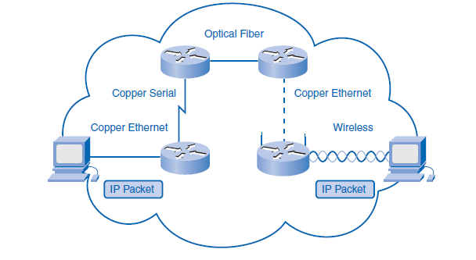
5. IPv4: Example Network Layer Protocol
Outline
IP is media independent, which means it is not concerned with the physical medium that carries the packet. Internetwork communication is likely to be a multimedia journey using a combination of wireless, Ethernet cable, fiber-optic cable, and other OSI Layer 1 media. The arrangement of bits in the IP packet and header will not be changed as the packet transfers from wireless to fiber or any other media.

Slide 13
5. IPv4: Example Network Layer Protocol
Outline
One important consideration, however, is the size of the PDU. Some networks have media restrictions and must enforce a maximum transmission unit (MTU). The MTU is determined by the OSI data link layer, and that requirement is passed to the network layer. The network layer then builds the packets according to specification. Should the packet come across a network that requires smaller packets, the router connected to the network will fragment the packets before forwarding them on the network’s medium. This process is called fragmentation.
IPv4 Packet: Packaging the Transport Layer PDU
IPv4 encapsulates, or packages, the transport layer segment or datagram so that the network can deliver it to the destination host. The IPv4 encapsulation remains in place from the time the packet leaves the network layer of the originating host until it arrives at the network layer of the destination host. The process of encapsulating data by layer enables the services at the different layers to develop and scale without affecting other layers. This means that transport layer segments can be readily packaged by existing network layer protocols.

Slide 14
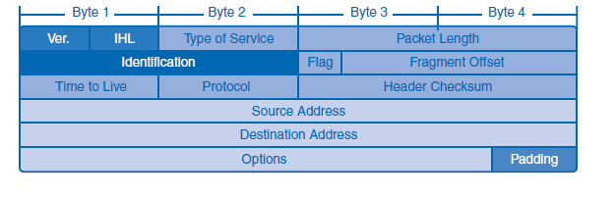
5. IPv4: Example Network Layer Protocol
Outline
IPv4 Packet Header
The IP header holds the delivery and handling instructions for an IP packet. For example, when a packet arrives on a router’s interface, the router needs to know whether the packet is IPv4 or IPv6. The router looks to a specific field in the header to see which type is arriving. The header also contains addressing information and other data about how to handle the packet along the way.

Slide 15
6. Networks: Dividing Hosts into Groups
Outline
Networks are communities of computers and other hosts, but in many ways, they are like human communities.
Computer communities are similar to human communities in that as they grow, they become more complex, and at some point, dividing the large networks into smaller, more manageable groups can make sense. As networks grow and divide, hosts still need to find each other to communicate. One of the major roles of the network layer is to provide a mechanism for addressing hosts in a way that allows all member hosts to find each other. As the number of hosts on the network grows, more planning is required to address the network so that it can be managed efficiently.
Creating Common Groups
Just as cities can be divided into geographic neighborhoods, large computer networks can be separated into internetworks. Departments and groups that share computers and servers are good candidates for dividing into groups from the large network into a common subnetwork, or subnet. Membership in a subnet requires following the rules of communication provided by the TCP/IP protocols.

Slide 16
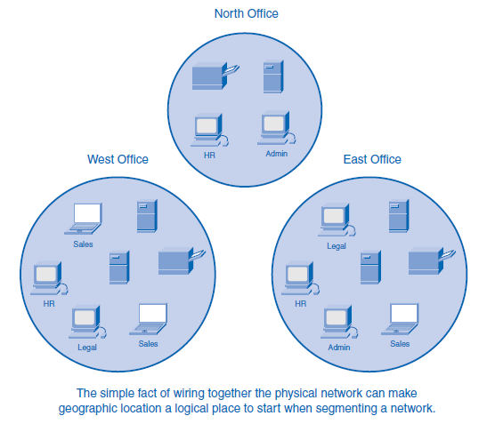
6. Networks: Dividing Hosts into Groups
Outline
1- Grouping Hosts Geographically
Grouping network hosts geographically is an economical way to improve communications by reducing overhead for the users, especially if most of their communication stays in the neighborhood. When communication leaves the subnet, it can be subject to external bandwidth issues.

Slide 17
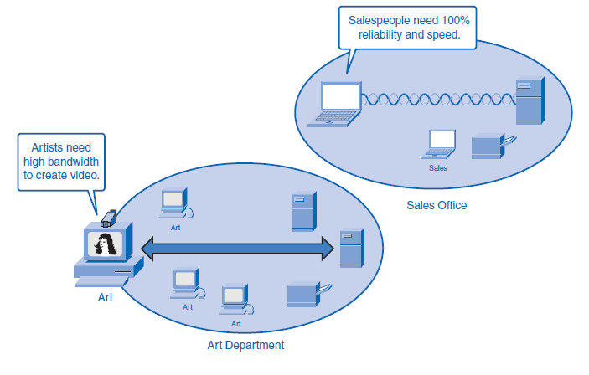
6. Networks: Dividing Hosts into Groups
Outline
2- Grouping Hosts for a Specific Purpose
People on a large network will likely use computers for many different reasons. The tools people use for work are increasingly software based and are requiring ever-increasing amounts of computing power to perform work tasks. The purpose of these tasks can be clerical, design, education, government administration, or e-commerce. Each purpose can have specialized software that can consume substantial resources. Whatever the purpose, a network must provide sufficient resources to allow people to work. It can make sense for a network manager to divide a network by purpose instead of geography so that people sharing a common purpose are also sharing common resources.

Slide 18
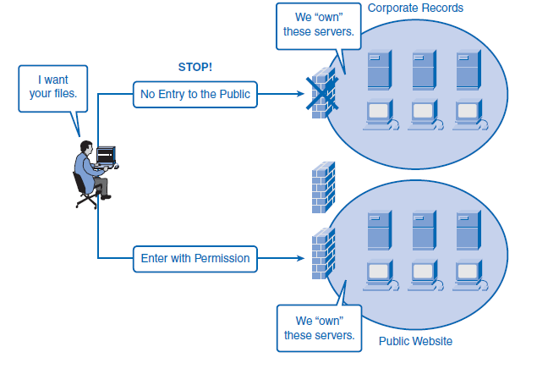
6. Networks: Dividing Hosts into Groups
Outline
3- Grouping Hosts for Ownership
Ownership of (and access to) information is another way to group users. Grouping by purpose and geography is concerned with efficient resources and reduced network overhead. In an ownership group, the main concern is security. In a large network, it is much more difficult to define and limit the responsibility and access for the network personnel. Dividing hosts into separate networks provides a boundary for security enforcement and management of each network.

Slide 19
6. Networks: Dividing Hosts into Groups
Outline
Why Separate Hosts into Networks?
As communities and networks grow larger, they present problems that can be alleviated by dividing the network into smaller, interconnected networks. In growing computer networks, some common issues arise, such as the following:
■ Performance degradation
■ Security issues
■ Address management

Slide 20
6. Networks: Dividing Hosts into Groups
Outline
Performance
Hosts on a network can be chatty devices. They are designed to broadcast news about themselves to all other users on the network. A broadcast is a message sent from one host to all other hosts on the network, and the purpose is usually to share its own information and to request information about other hosts.
Broadcasts are a necessary and useful tool used by protocols as part of the communication process. When a group of computers is networked, they generate broadcasts to each other, and the more users on a network, the more broadcasting consumes bandwidth.
As users are added, performance quality decreases because the broadcast traffic takes up valuable bandwidth that can otherwise be carrying productive data. Because broadcasts do not travel beyond the network boundary, the network is known as a broadcast domain. Isolating groups of users into smaller networks reduces the size of broadcast domains and restores performance.

Slide 21
6. Networks: Dividing Hosts into Groups
Outline
Security
As more of the world’s businesses and consumers shift their trade onto the Internet, so too are thieves and cyber-pirates finding new ways to exploit the web for criminal gain. Policing a large community like the Internet can be a daunting task, but tending to a small neighborhood’s security needs is much more manageable. The original IP-based network that has now become the Internet once consisted of a small number of trusted users in government agencies and research organizations. In such a small community of known users, security was a fairly simple issue. Since then, the Internet has grown beyond recognition, and now individuals, businesses, and organizations have developed their own IP networks that can link to the Internet. The hosts, network equipment, and data are the property of those network owners. By isolating themselves from the larger networks and shielding their devices from public access, companies and organizations can better protect themselves from spies and thieves. A local network manager can more easily control outside access to the smaller network. Internetwork access within a company or organization can be similarly secured.

Slide 22
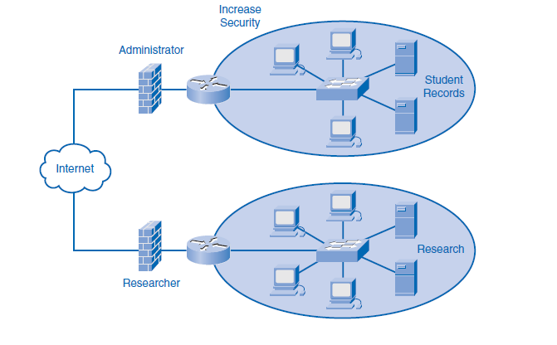
6. Networks: Dividing Hosts into Groups
Outline
Security
For example, a college network can be divided into administrative, research, and student subnetworks. Dividing a network based on user access is an effective way to protect the organization’s interests and employee privacy. Such access restrictions can protect an organization from both unauthorized internal access and malicious external attacks. Security between networks is controlled in an intermediary device (a router or firewall appliance) at the perimeter of the network. The firewall function can be configured to allow only known, trusted data and users to access the network.

Slide 23
6. Networks: Dividing Hosts into Groups
Outline
Address Management and Hierarchical Addressing
A group of hosts in a network can be compared to a small neighborhood in a town with a helpful local post office. The postal worker knows all the residents and their streets and street addresses, but he does not share that information with anyone outside the neighborhood. Just as the neighborhood post office has a postal code that identifies the physical location of the neighborhood, a network has a network address that identifies the logical location of the network on a router. (Because computer networks are not restricted to physical locations, IPv4 provides a logical system of keeping track of networks.) An IPv4 address contains both network bits that identify a logical network address and host bits that contain a local “inside the neighborhood” address of the end device. In the neighborhood analogy, residents (hosts) can communicate with others in their neighborhood quite easily. They know each other’s street addresses and trust each other, and they are constantly chatting and checking up on each other. If they need to send messages somewhere outside the neighborhood, however, they give the message to the postal worker, who figures out how to forward the message to another post office in the neighborhood of the destination.

Slide 24
6. Networks: Dividing Hosts into Groups
Outline
Address Management and Hierarchical Addressing
This frees the residents on the inside of the neighborhood from having to know how to communicate with all the possible addresses outside their known neighborhood. The post office serves as a community gateway to communication with the world outside the neighborhood.
When messages arrive from the outside, they are addressed with information containing the address of both the neighborhood post office (the postal code) and the street address (the local address). The helpful postal worker takes all the messages addressed to the neighborhood, sorts them by address, and delivers the message inside the neighborhood to the proper recipient. This example also describes the basic function of network addressing. Routers act as postal workers at post offices for small networks by taking care of messages going out and serving as a general destination and sorting station for messages coming in. The router a network uses to send and receive messages beyond the network is called a gateway router.

Slide 25
6. Networks: Dividing Hosts into Groups
Outline
Address Management and Hierarchical Addressing
The address is divided into two parts: the network address and the host address. The network portion of the address tells routers where to find the general network, and the host portion is used by the last router for delivery inside the network. The type of addressing in the analogy is considered hierarchical. Hierarchical addressing is read from the most general information to the most specific. When a letter or package is sent through the postal service, there is an addressing protocol.

Slide 26
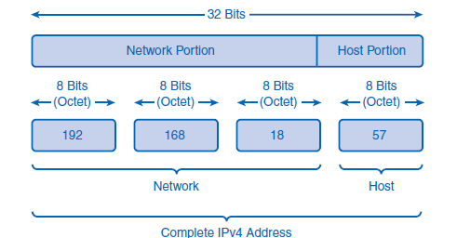
6. Networks: Dividing Hosts into Groups
Outline
Dividing Networks from Networks
The IPv4 address is composed of 32 bits divided into two parts: the network address and the host address. The network portion of the address acts like a postal code and tells routers where to find the general neighborhood of a network. Routers forward packets between networks by referring only to the network portion. When the packet arrives at the last router, like a letter arriving at the last postal station, the local portion of the address identifies the destination host.

Slide 27


THANK YOU

